Slide 1
Packer Vagrant.
Machine image creation automation
Here is an example workflow:
You use Packer to build a Vagrant Box for the virtualbox provider
The vagrant-cloud post-processor is configured to point to the box hashicorp/foobar on Vagrant Cloud via the box_tag configuration
The post-processor receives the box from the vagrant post-processor
It then creates the configured version, or verifies the existence of it, on Vagrant Cloud
A provider matching the name of the Vagrant provider is then created
The box is uploaded to Vagrant Cloud
The upload is verified
The version is released and available to users of the box

Slide 2
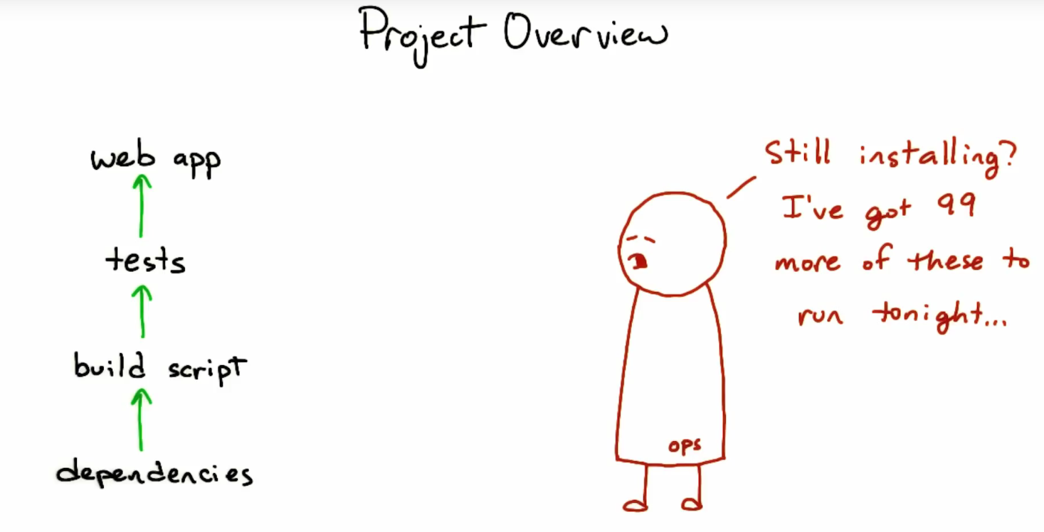

Slide 3
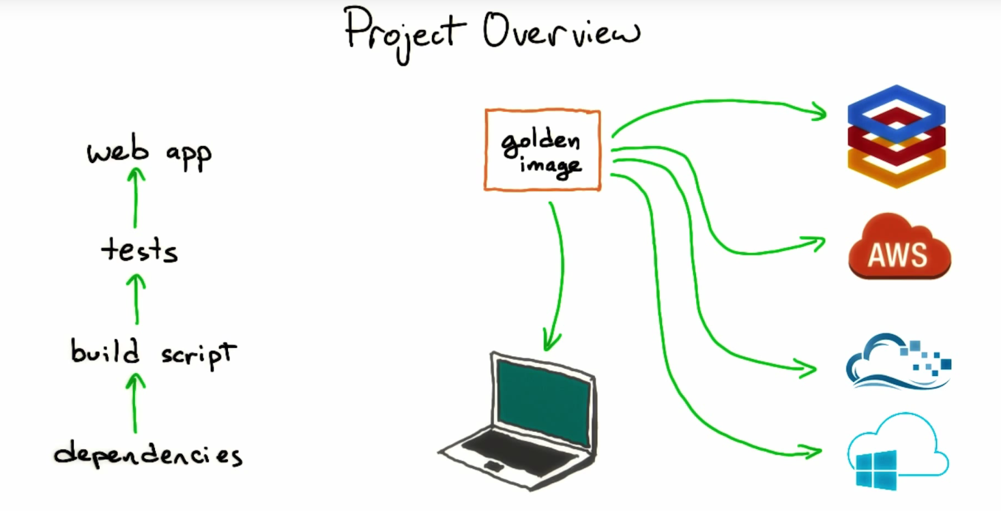

Slide 4
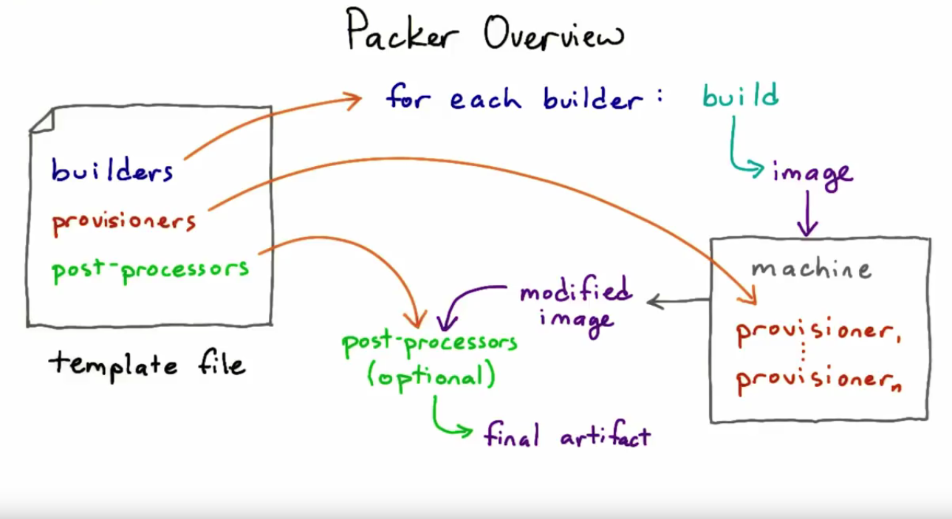

Slide 5
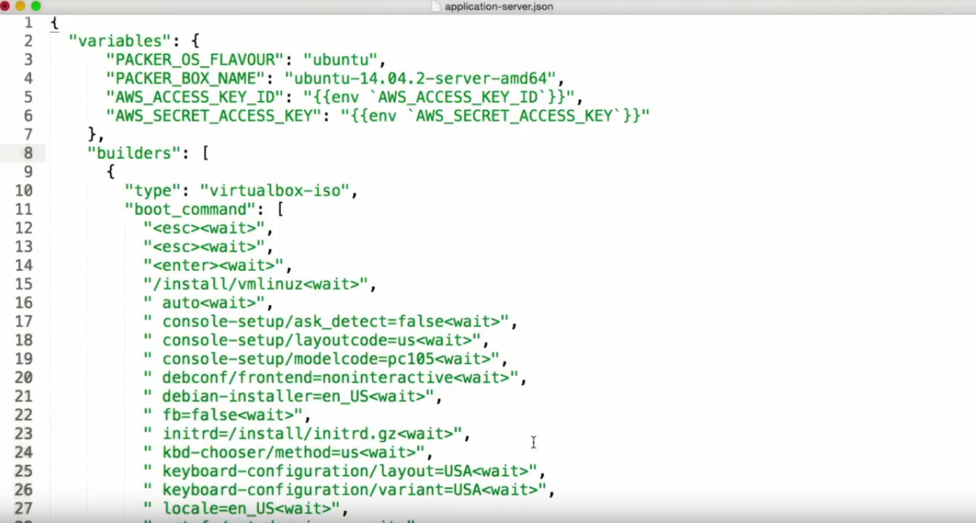

Slide 6
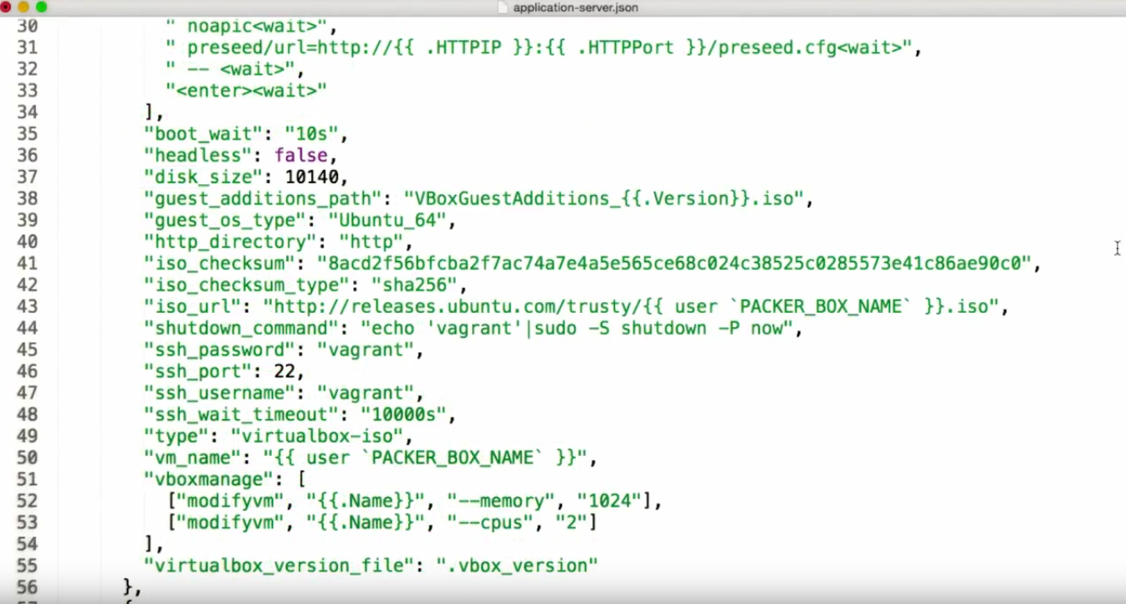

Slide 7
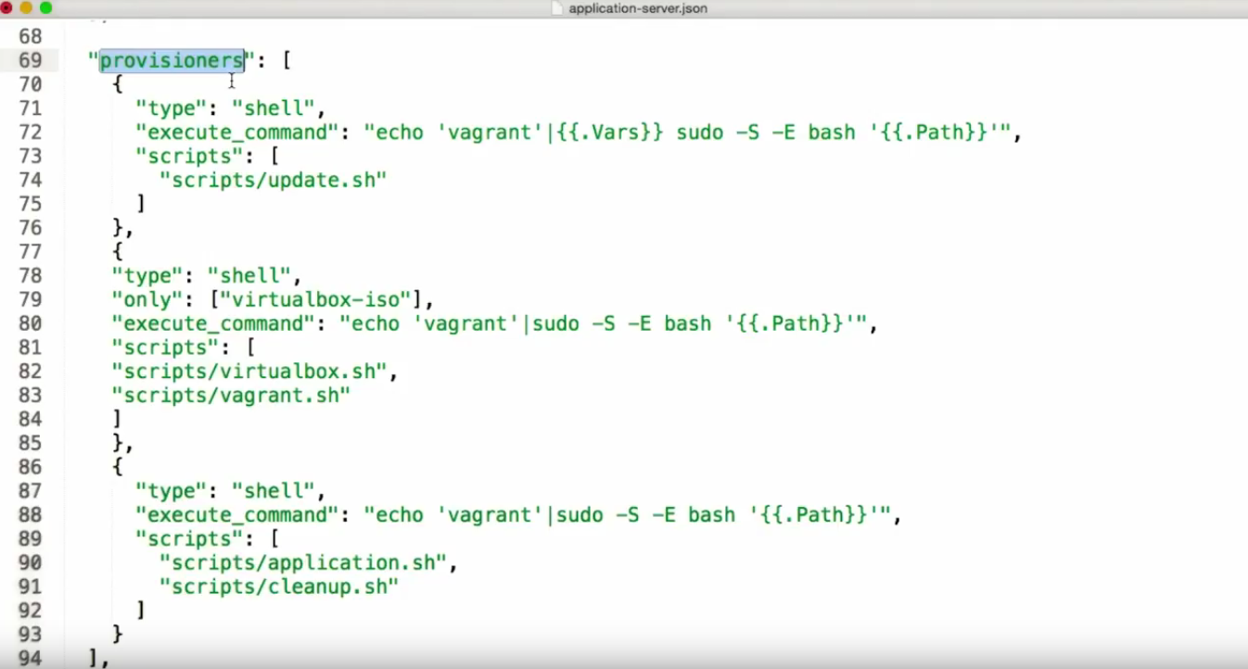

Slide 8
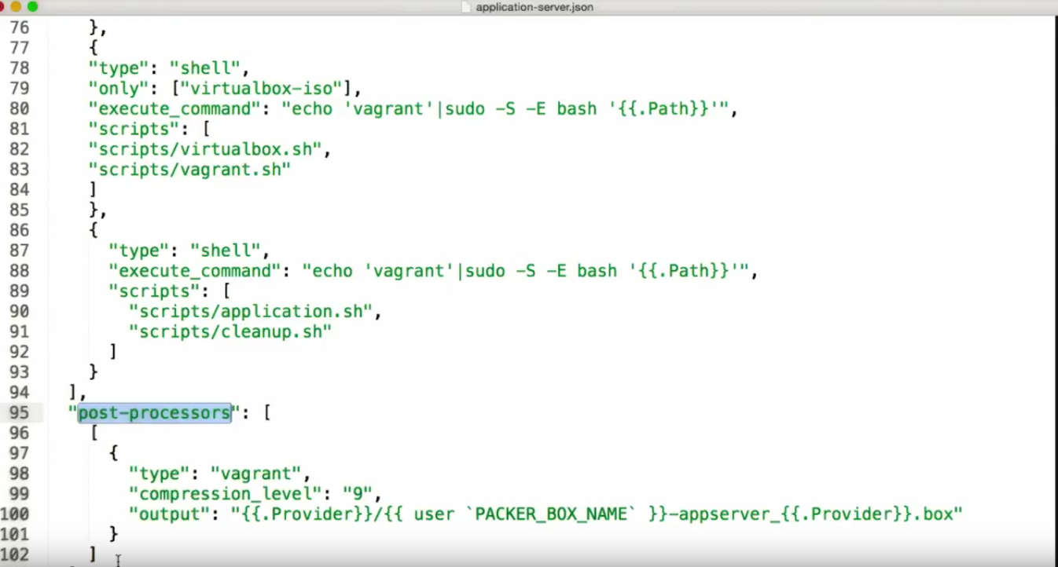

Slide 9
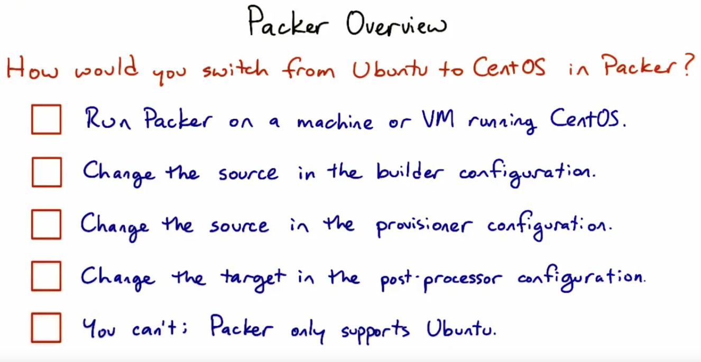

Slide 10
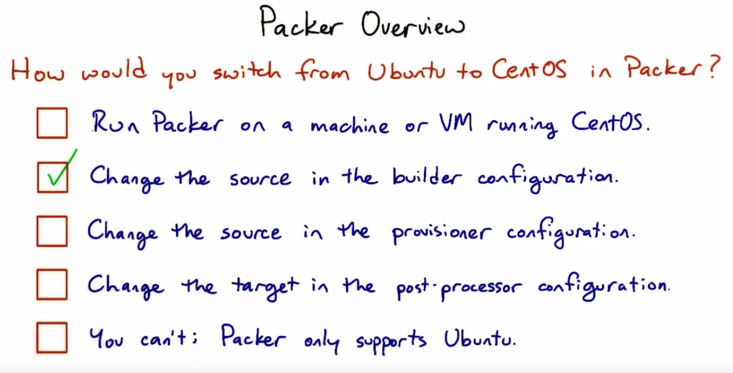

Slide 11
IT Orchestration
Orchestration is the automated configuration, coordination and management of computer systems and software.
Examples of tools: Ansible, Puppet, Salt, Terraform, AWS CloudFormation.
Container Orchestration: Kubernetes software, managed services as AWS EKS, AWS ECS, Amazon Fargate.

